Slide 1
Task 2 Report
Name: Abhishek Shashikant Chaphekar
Vulnerability Name: Out-of-Date Version of Apache
Ethical Hacking Internship

Slide 2
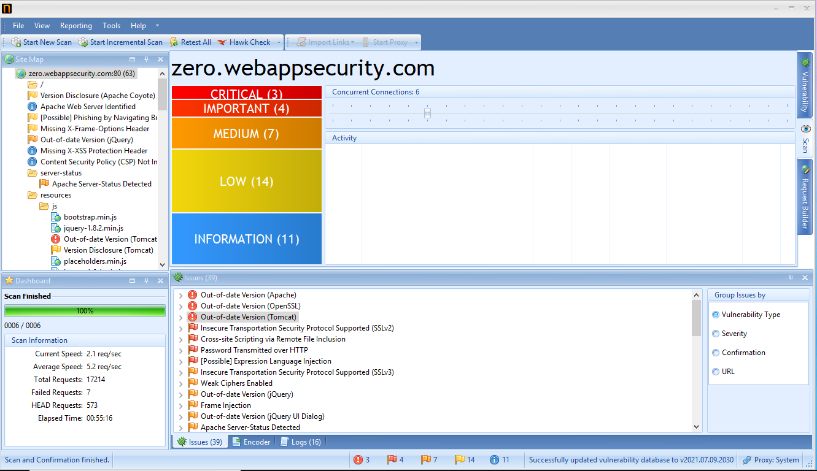

Slide 3
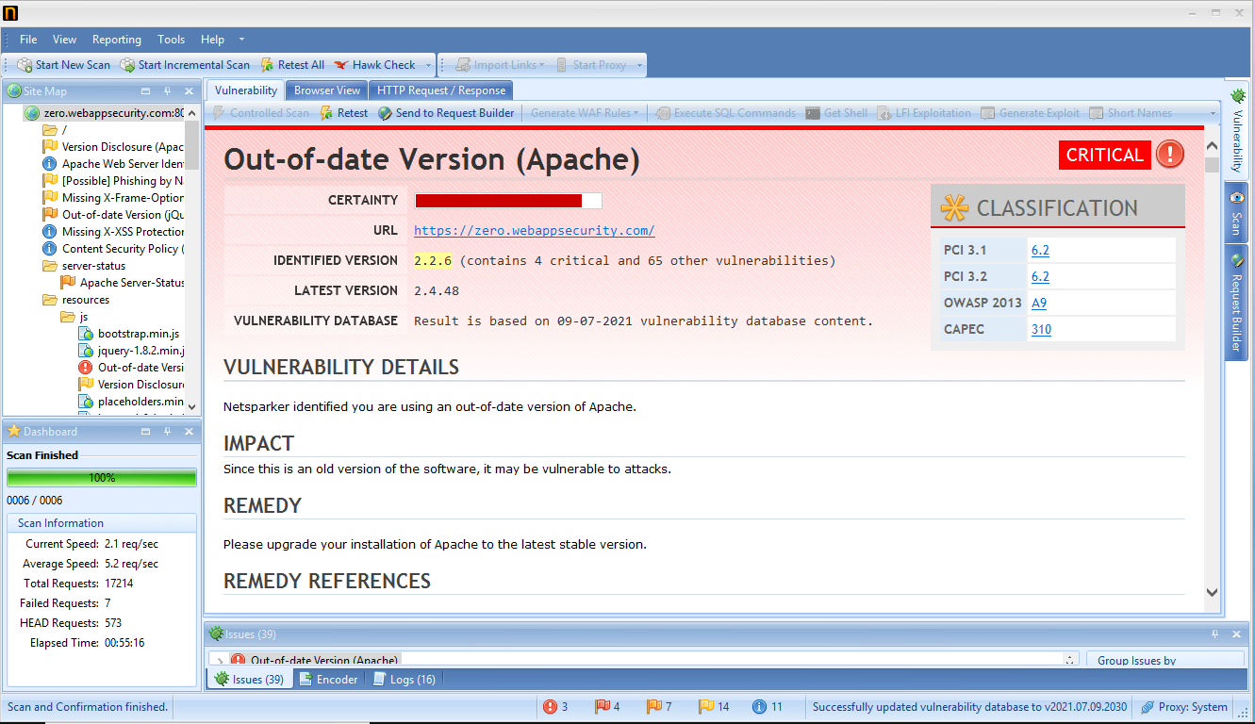

Slide 4
Vulnerability Name: Out-of-Date Version of Apache
URL: http://zero.webappsecurity.com/
Currently Installed Version: 2.2.6
Latest Available Version: 2.4.48
Severity: Critical
Reported By: Abhishek Shashikant Chaphekar
Reported On: 13/07/2021
Description: The system is using outdated version of Apache.
Steps to Reproduce: Just run a version scan and you will come to know that you are using outdated version of Apache.
Impact: The attacker will simply run a version scan and he/she will come to know that you are using outdated version
of Apache.
Since this is an old version of the software, it may be vulnerable to attacks.
Solution: Just update the Apache to the latest version available.

